Slide 1
Test Conductor
Scenario-based Test Generation
I-Logix, Inc.

Slide 2
Cost of Testing
Analysts have determined that 70% of the time spent in developing new products is consumed by testing;
… and 50% of the development cost is related to testing…

Slide 3
Reducing Testing Cost… How?
Truly integrating testing throughout the development process
Using design-level testing
Enabling a use-case driven iterative development process
Detecting errors early on
Enabling an effective and cooperative collaboration between testers and developers

Slide 4
Rhapsody TestConductor
We will propose a testing process
    Uses standard UML design notation
    Scenario-based
Address testing activities during
    Design
    Unit testing
    Regression testing
Use PBX example

Slide 5
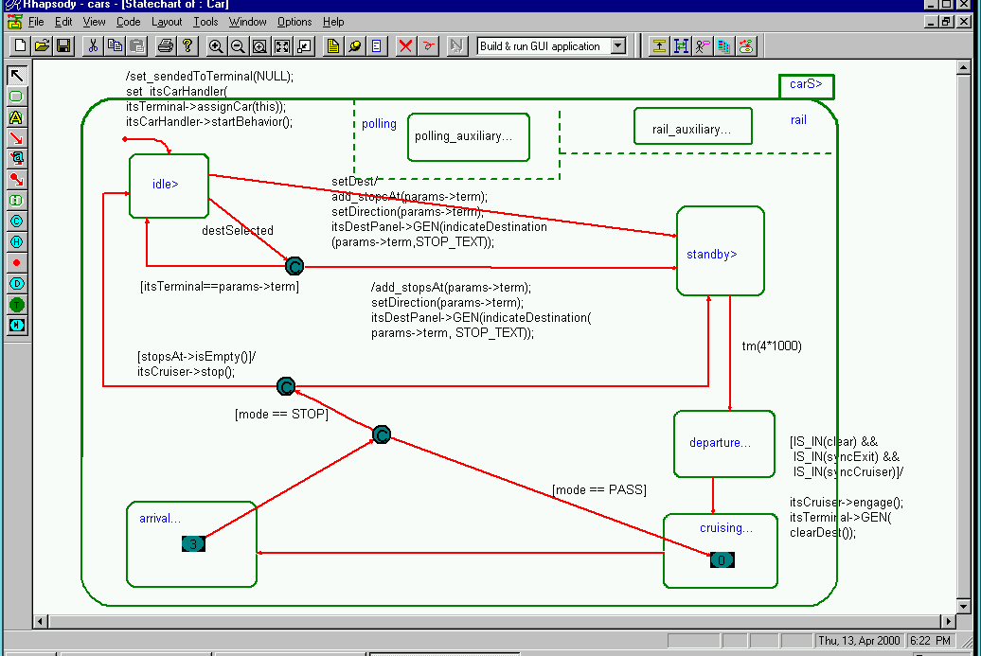
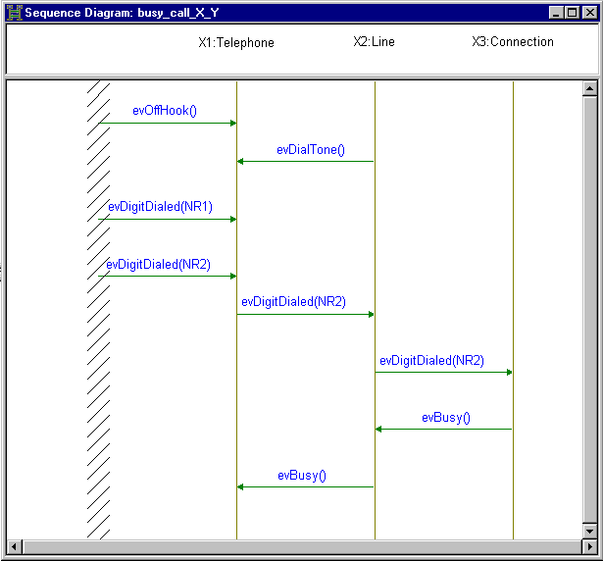
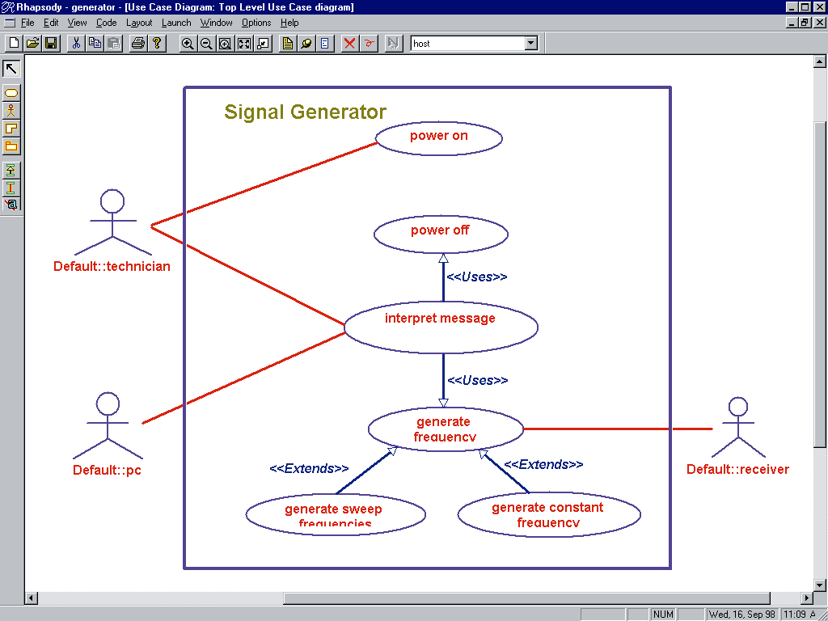
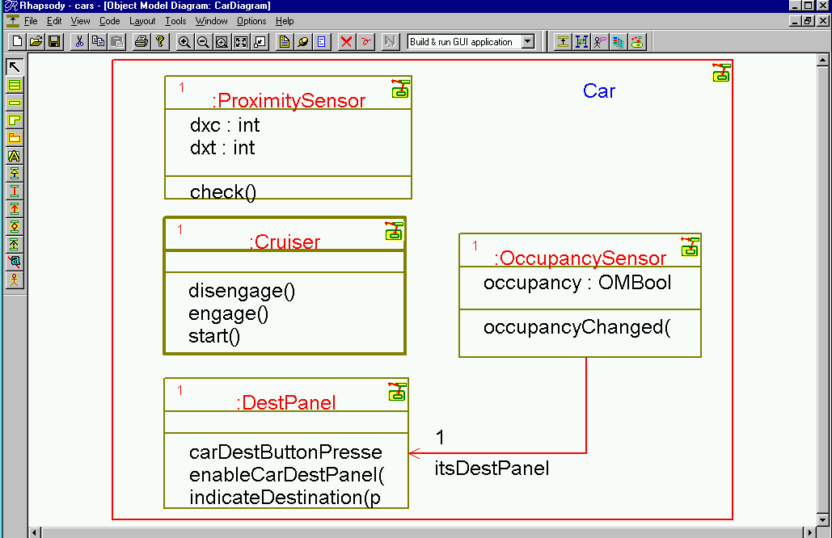
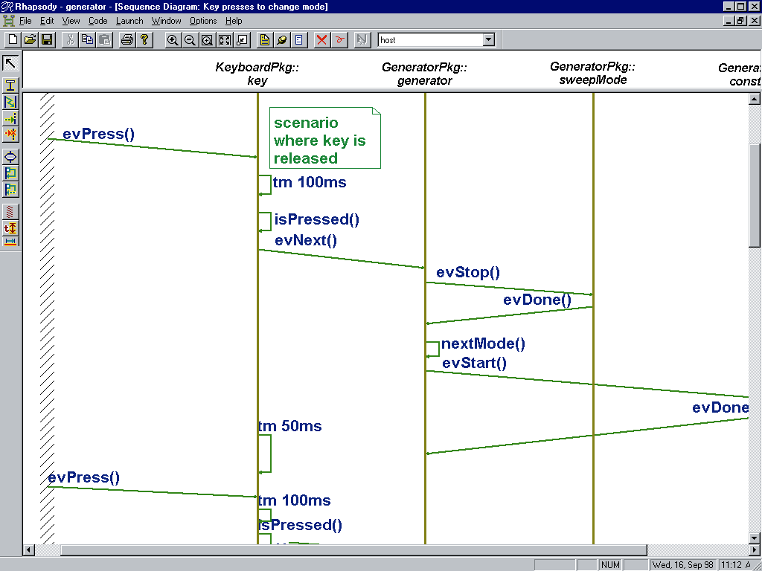
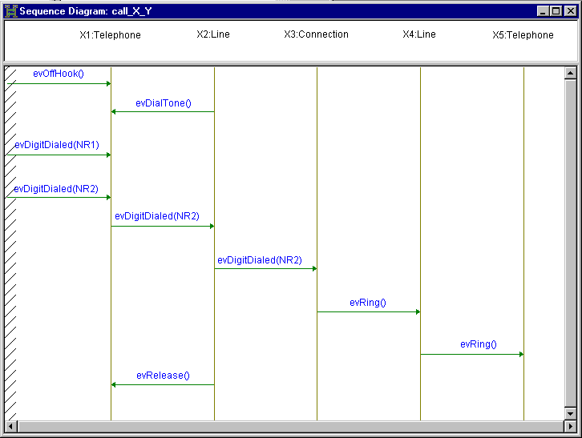
Testing Your Application
Overview…
Requirements
Design Properties
As Monitors
& TestDrivers
Rhapsody
Scenario
based
Test
Generation
Stimulate...
...Monitor
Tool Generated
Sequence Diagrams
% Completion
% Completion
Pass
Pass
Fail
Fail

Slide 6
Testing Your Application
On Going Design-Debugging…
Requirements
Design Properties
As Monitors
& TestDrivers
Rhapsody
Scenario
based
Test
Generation

Slide 7
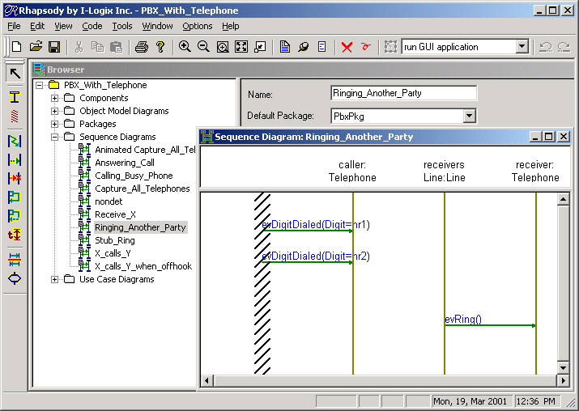
Analysis Scenario As… Monitor
Dialing a phone number
should make the phone ring…

Slide 8
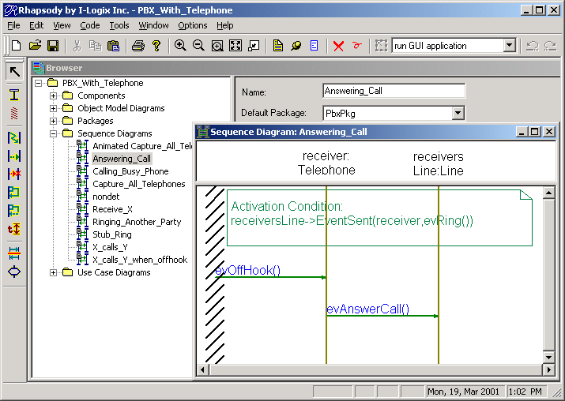
Design Property As… Monitor
Putting a ringing phone off the hook
sends an evAnswerCall to the line…

Slide 9
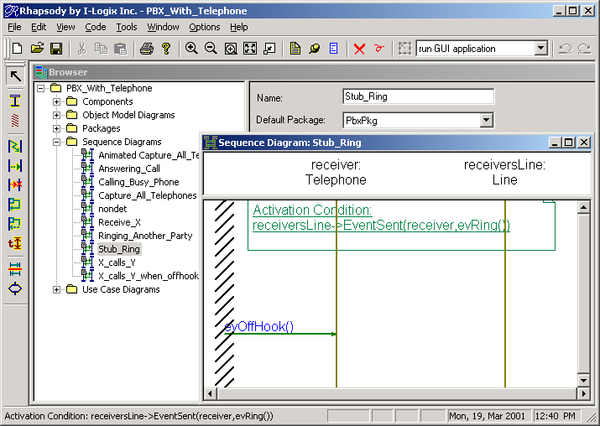
A Stub… As an Assistant
When a phone rings… get it off the hook.

Slide 10
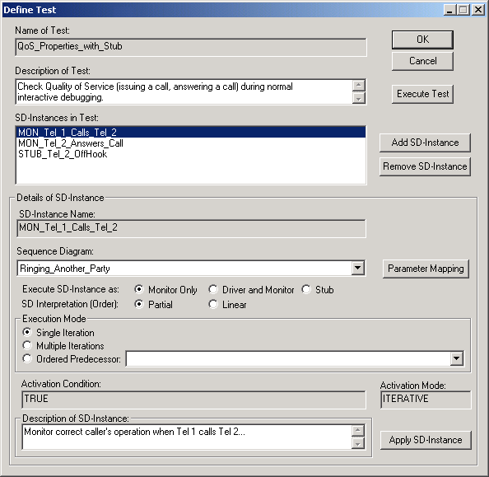
Setting-up a Test
is

Slide 11
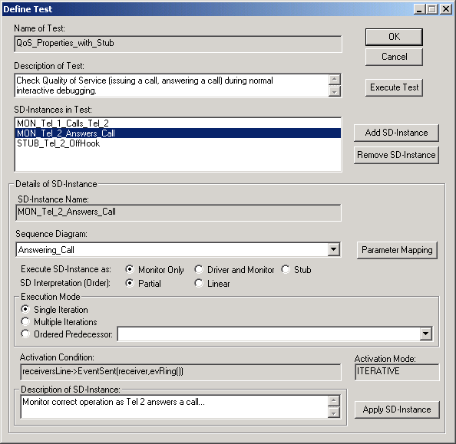
Setting-up a Test
is

Slide 12
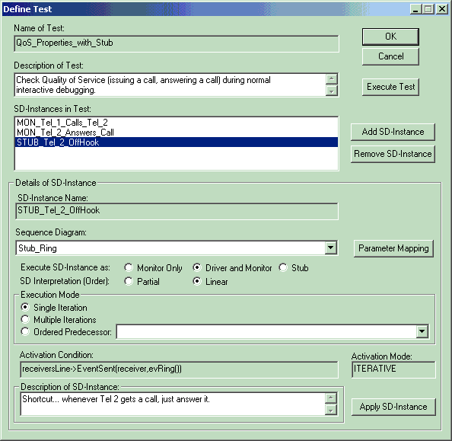
Setting-up a Test
is

Slide 13
Testing During Design Debugging
Reuse analysis-scenarios as monitors
Create you own monitors
Debug your design “as usual”
  Execute monitors to detect errors ASAP
    “Monitors execute in the background”
  Design can be augmented with stubs

Slide 14
Testing Your Application
Test drivers… for unit testing…
Rhapsody
Scenario
based
Test
Generation
Stimulate...
...Monitor
% Completion
Pass
Fail

Slide 15
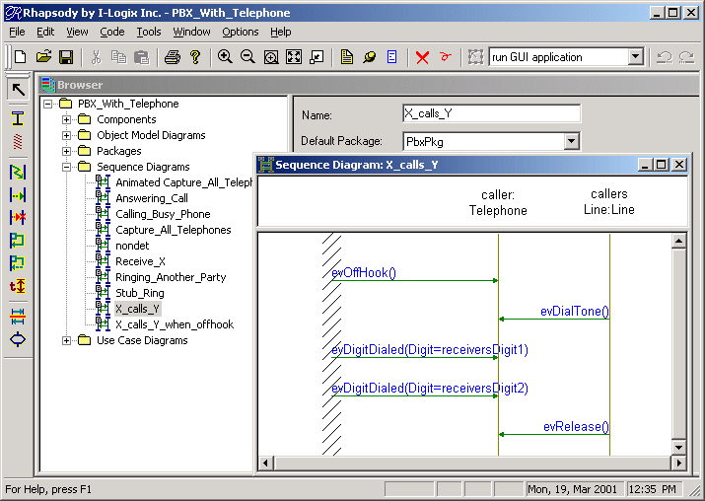
Analysis Scenario As Test Driver
How to make a call… The Caller side…
Rhapsody plays the System Border

Slide 16
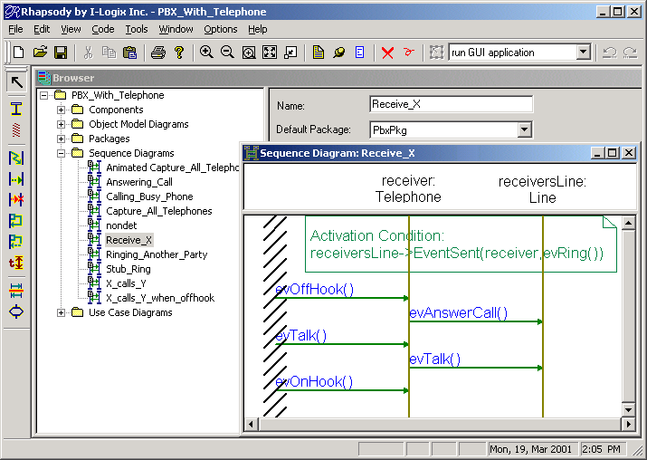
Analysis Scenario As Test Driver
How to answer a call… The Receiver side…

Slide 17
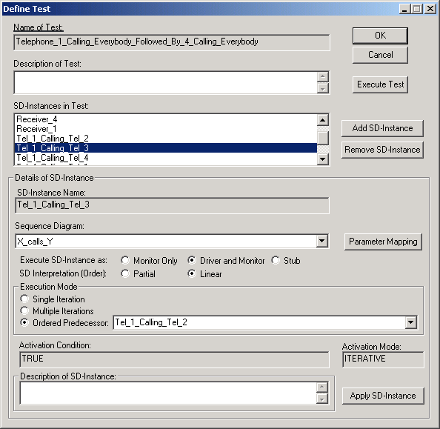
Tests Instantiations
Tel_1 calling others, Tel_4 calling others
X_calls_y:
  1 ⇒ 2
  1 ⇒ 3
  1 ⇒ 4
  4 ⇒ 1
  4 ⇒ 2
  4 ⇒ 3

Slide 18
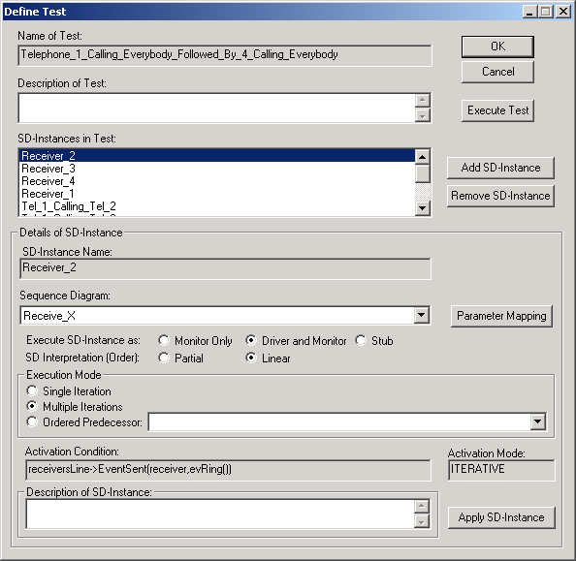
Tests Instantiations
Tel_1 calling others, Tel_4 calling others
X_calls_y:
  1 ⇒ 2
  1 ⇒ 3
  1 ⇒ 4
  4 ⇒ 1
  4 ⇒ 2
  4 ⇒ 3
Receiver_x:
  Receiver_1
  Receiver_2
  Receiver_3
  Receiver_4

Slide 19
Testing During Unit Testing
Reuse analysis-scenarios as
test drivers
Create you own test drivers
Configure and execute end-to-end tests
  Test can be augmented with stubs and monitors

Slide 20
Testing Your Application
Extensive Regression Test
Rhapsody
Scenario
based
Test
Generation
Stimulate...
...Monitor
Tool Generated
Sequence Diagrams
% Completion
Pass
Fail

Slide 21
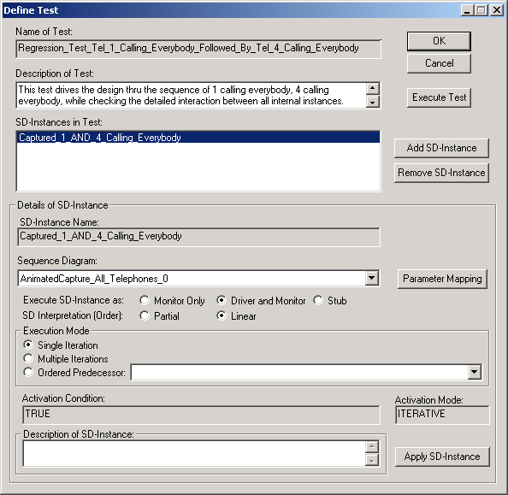
Regression Tests
ReUse detailed SD, generated thru model/design execution
Execute test for quick pass/fail
If needed, save resulting SD (w/error highlighted)

Slide 22
Testing During Regression Test
Reuse sequence diagrams generated by Rhapsody as a test driver
  Participating instances are user-defined
  Usually, regression test SD is very detailed
Create your own regression tests
Test execution:
  Rhapsody drives according to system border
  Rhapsody monitors ALL interactions between instances
  Test can be augmented with stubs and monitors

Slide 23
Testing Your Application
With Scenario-based Test Generation
Requirements
Design Properties
As Monitors
& TestDrivers
Rhapsody
Scenario
based
Test
Generation
Stimulate...
...Monitor
Tool Generated
Sequence Diagrams
% Completion
% Completion
Pass
Pass
Fail
Fail

Slide 24
Rhapsody TestConductor
+ AppliedMicro’s CodeTest
Analyze performance of the Rhapsody generated application
As the test executes…
  Code level trace
  Coverage analysis
  Memory analysis
  Performance analysis
  Decision coverage
  Etc…

Slide 25
Rhapsody TestConductor
Graphical test definition
Stubs, monitors and test drivers
Easy to create complex tests by simply instantiating parameterized tests
Easy to define, easy to execute extensive regression tests
Graphical failure analysis

Slide 26
Reducing Testing Cost… By…
Truly integrating testing throughout the development process
Using design-level testing
Enabling a use-case driven iterative development process
Detecting errors early on
Enabling an effective and cooperative collaboration between testers & developers
Thus delivering a better product… quicker…

Slide 27
Vision Moving Forward…
Two additional complementary offerings:
  Specification-based test generation
    Generate scenarios to cover all states/transitions/etc.
    Scenarios used as inputs to TestConductor
  Model checking
    Formal verification of properties
    Properties described as Scenarios

Slide 29
Tool Architecture
Rhapsody
Generated App
Stimuli
Back-Animation Data
Rhapsody
“Simulator”
TOM API
Execution
Control
Back-Animation
Data
Stimuli
Scenario based
Test Generator
Input
Scenarios
Output
Scenarios
COM API
SD API
Test
Definition

